Slide 1
Balance Sheets and Trading
Rajiv Sethi and the CORE Team

Slide 2
Overview
Balance Sheets: Assets, Liabilities, and Net Worth
Interest Rates and Consumption Expenditure
Trading in Continuous Double Auctions
Bids, Asks, and Order Books
Reading: The Economy Units 10.7 to 10.11 and 11.5 to 11.6

Slide 3
Balance Sheets

Slide 4
Assets, Liabilities, and Net Worth
An asset is something of value you own
A liability is something of value (to others) that you owe
Your home, cars, bank balance, retirement account are assets
Your mortgage, student loans, personal loans are your liabilities
All financial assets have counterpart liabilities
So your mortgage (liability) is an asset for the issuing bank
Your net worth or wealth is your assets minus your liabilities

Slide 5
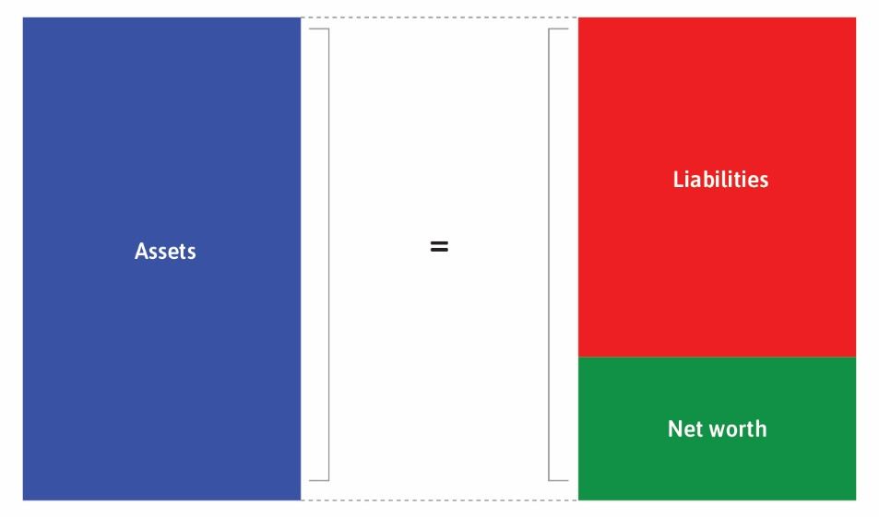

Slide 6
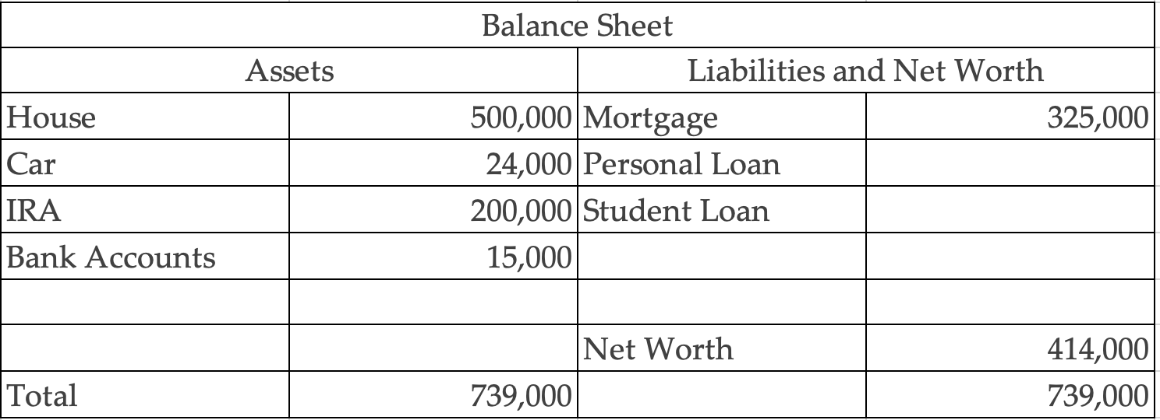

Slide 7
Balance Sheet Changes
If value of asset changes, net worth will change
Example: drop in real estate prices
Mark-to market accounting: balance sheet adjusted based on market prices
What happens to net worth if home value drops by a half?
What if both home and IRA drop by a half?

Slide 8
Interest Rates & Expenditure

Slide 9
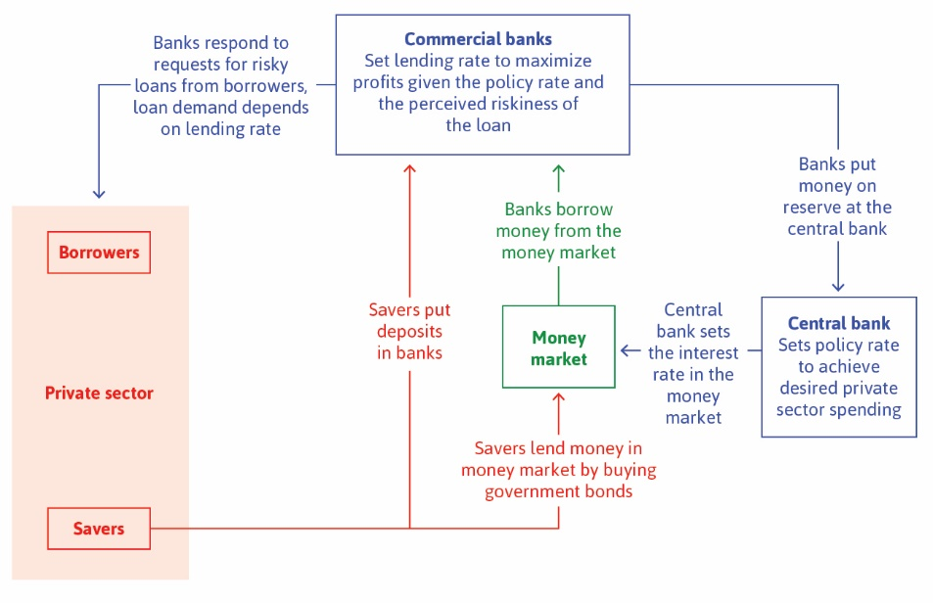

Slide 10
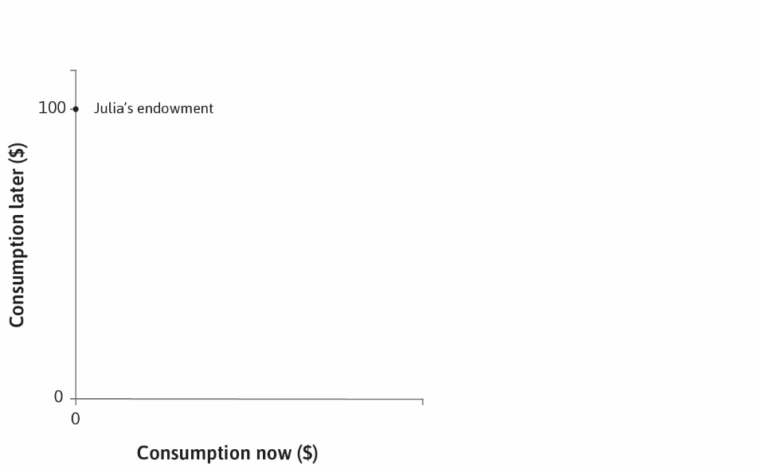

Slide 11
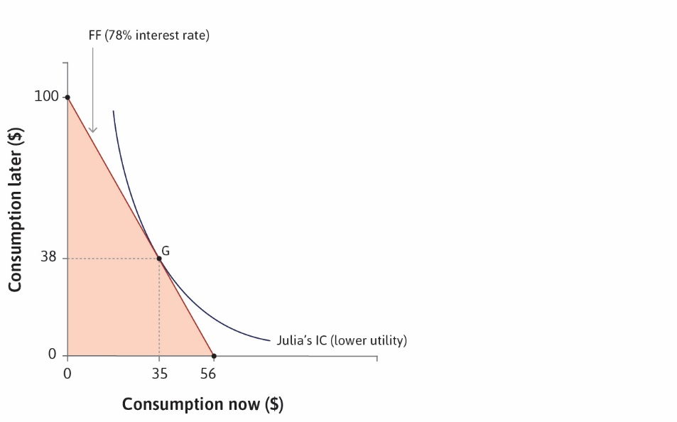

Slide 12
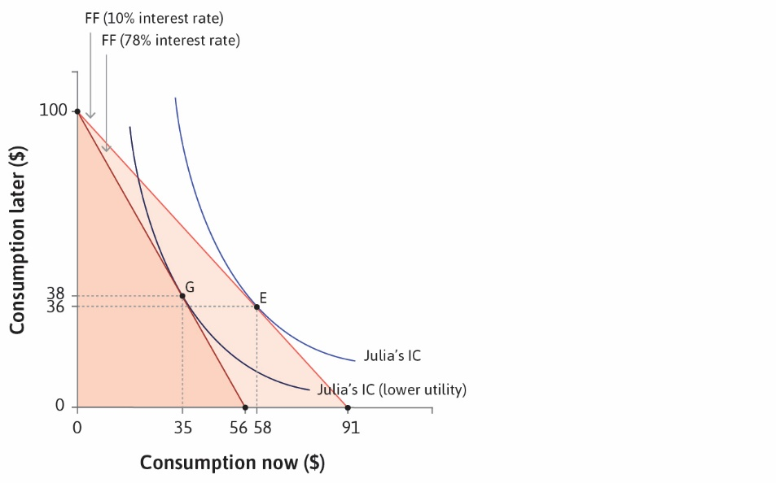

Slide 13
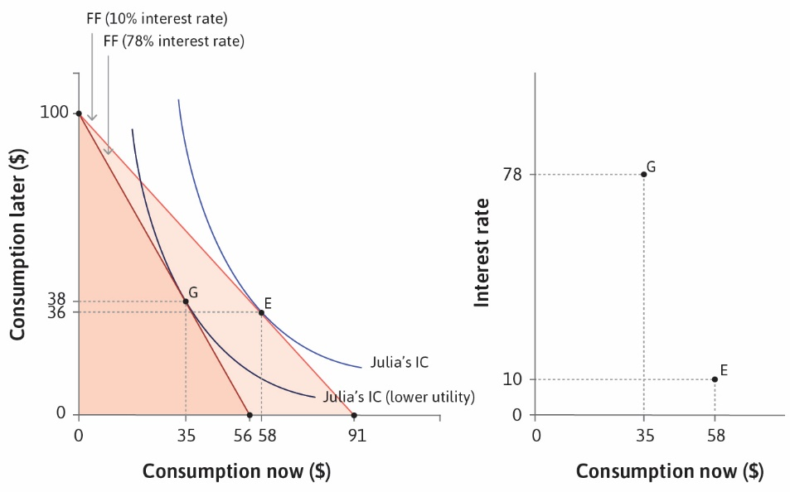

Slide 14
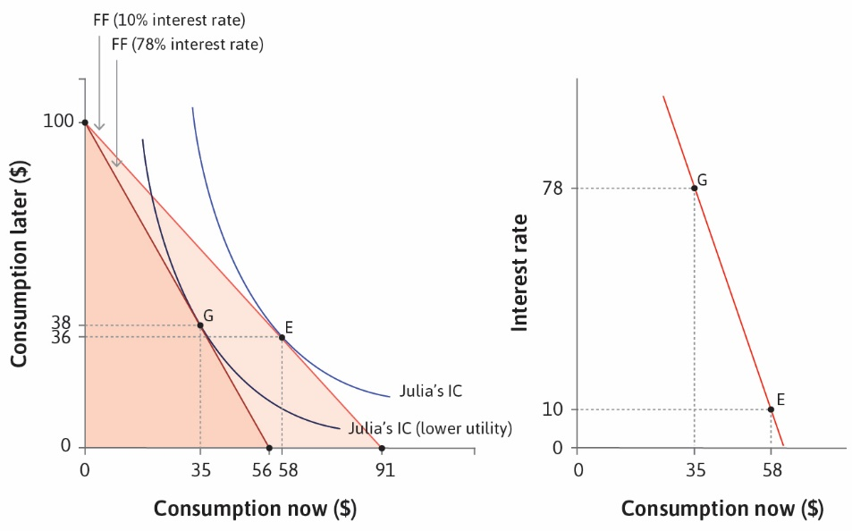

Slide 15
Trading

Slide 16
Continuous Double Auctions
Shares in companies trade on (electronic) stock exchanges
Trading is based on a continuous double auction
Order processing based on price-time priority
Orders specify both price and quantity (called a limit order)
Example: Buy 100 shares at $95 per share (this is called a bid)
Meaning: I’m prepared to buy 100 shares if I can get them at $95 or lower
Example: Sell 300 shares at $98 per share (this is an ask or offer)
Meaning: I’m prepared to sell 300 shares if I can $98 or higher for them

Slide 17
Trading Rules
Orders either result in a trade, or enter an order book
Order book has two sides: bid and ask
Top of the bid side is the best available price if you want to sell
Top of the ask side is the best available price if you want to buy
Orders are marketable of they can trade, non-marketable otherwise
Marketable orders are compatible with orders in the book
Trade at the price in the book (not the price of arriving order)
Consider an example (next slide)

Slide 18
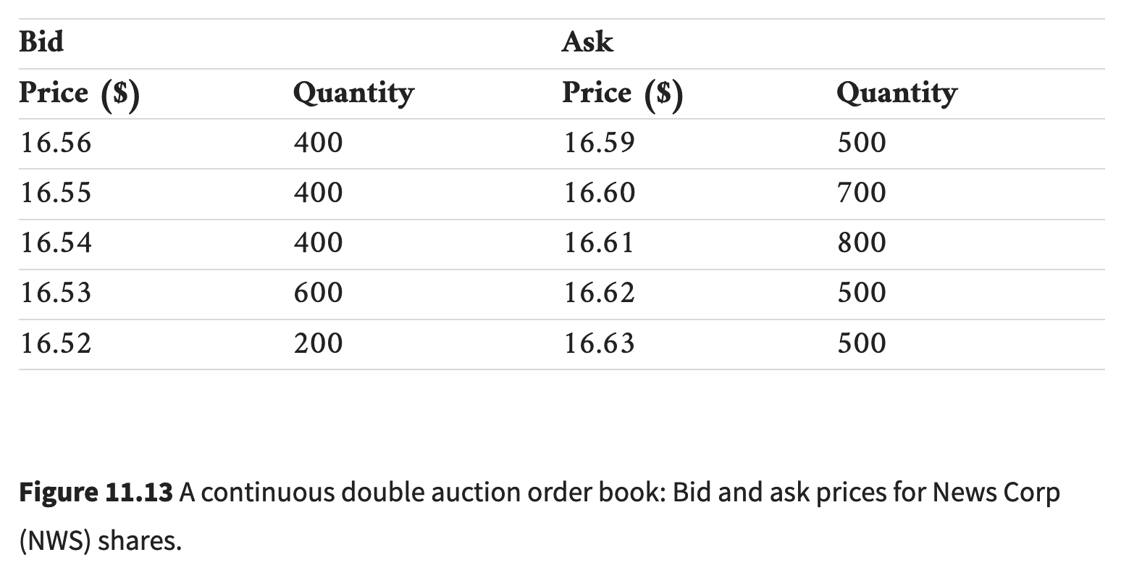

Slide 19
Example
What is the best bid? How many shares available?
What is the best ask? How many shares available?
Suppose order arrives: bid to buy 100 shares at $16.55
Will it trade or enter book? What will book look like after processing?
Suppose order arrives: ask to sell 500 shares at $16.55
Will it trade or enter book? What will book look like after processing?
What does order book look like during trading session? Next slide

Slide 20
